Slide 1

Assignment 5 – Remote Management
Daphne Camodoc

Slide 2
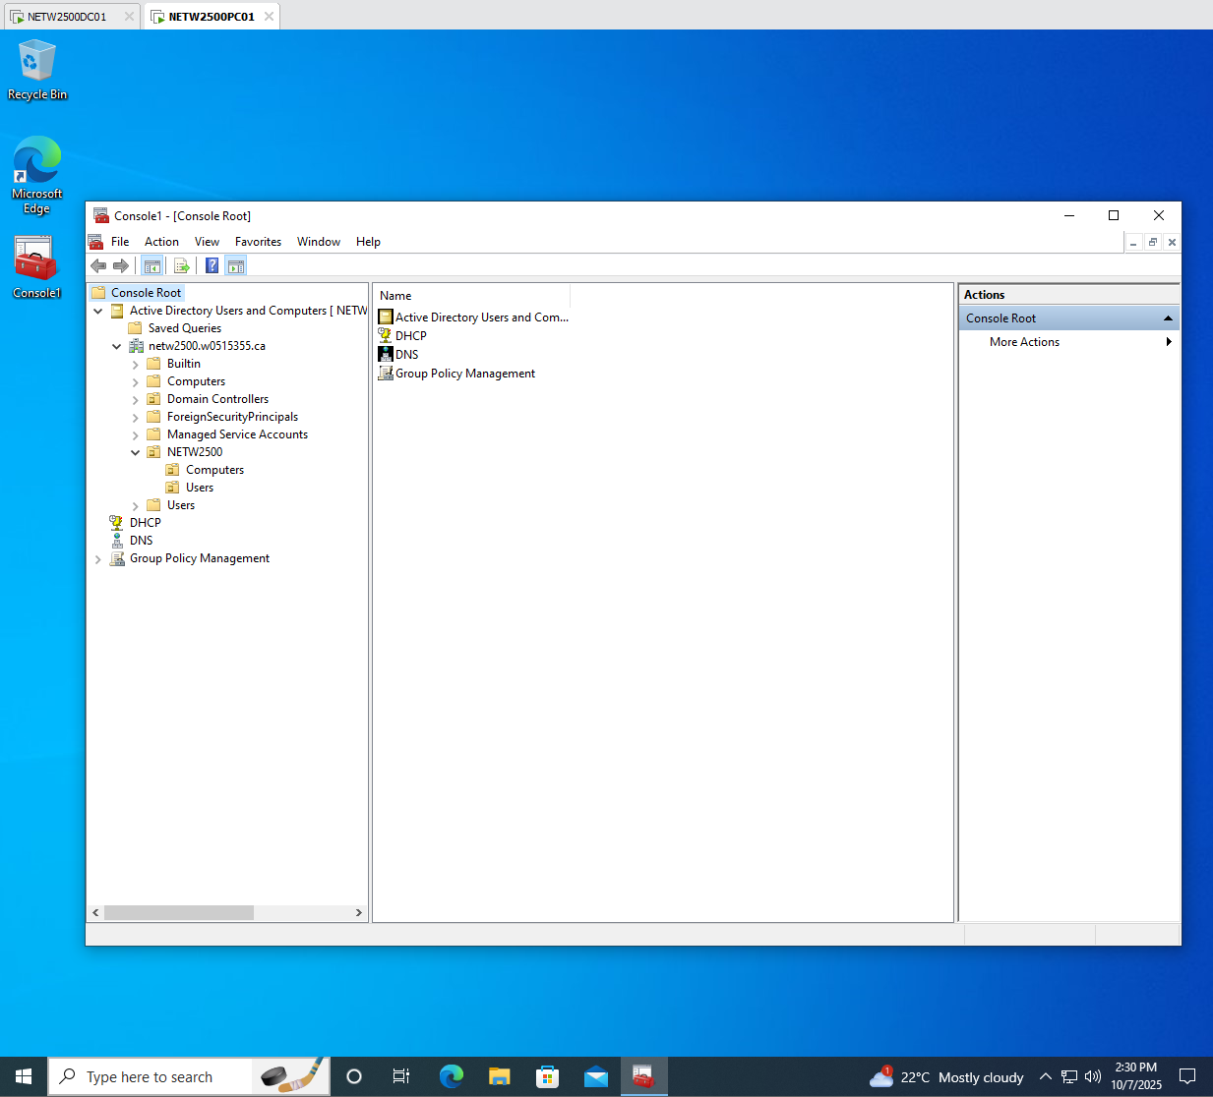
Saved MMC and its snap-ins

Slide 3
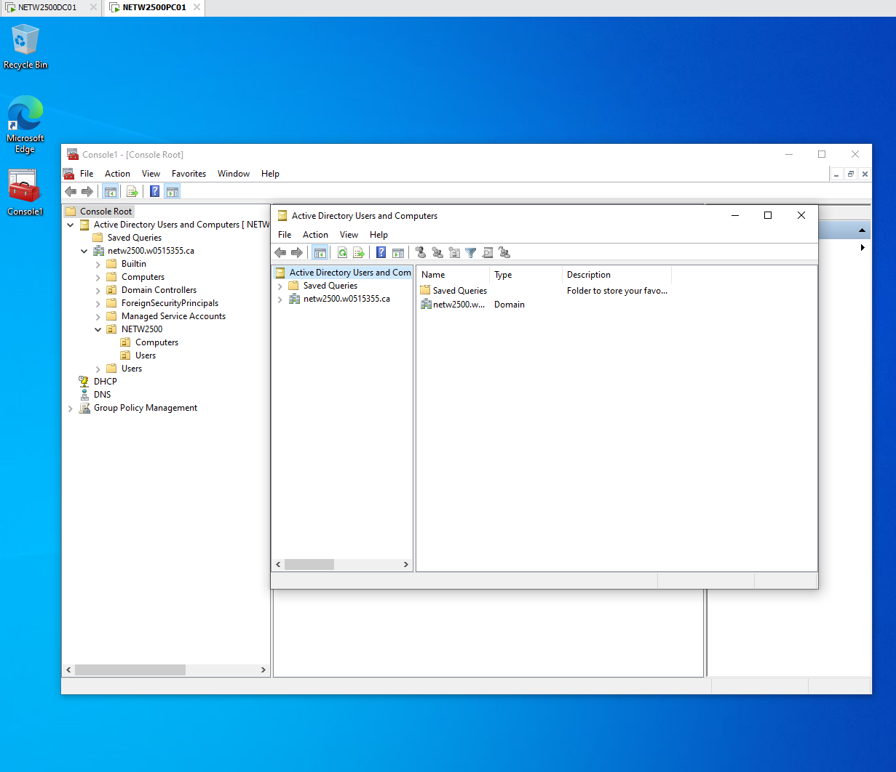
Active Directory Users and Computers

Slide 4
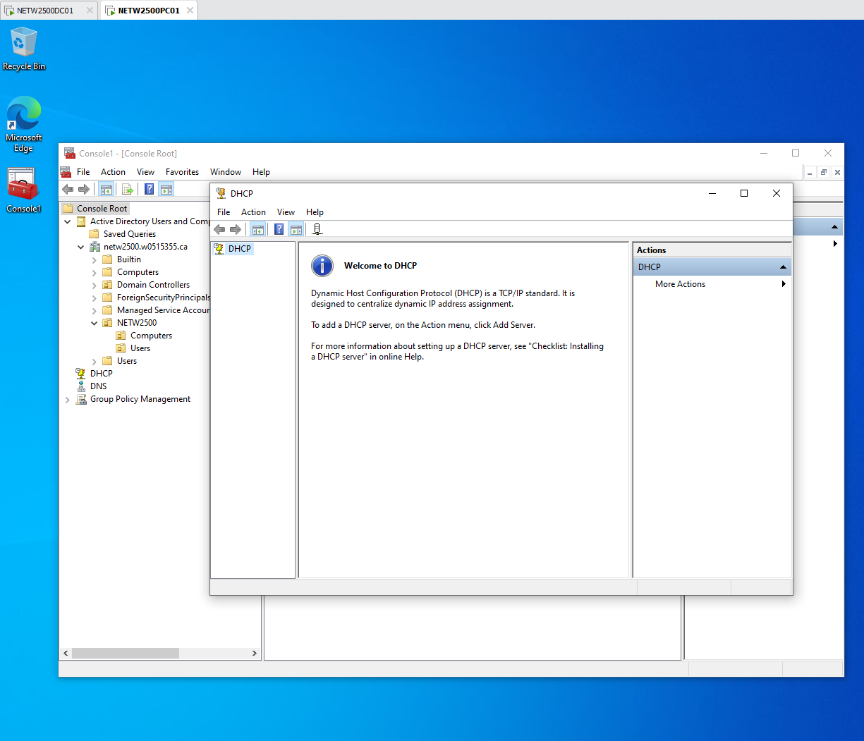
DHCP

Slide 5
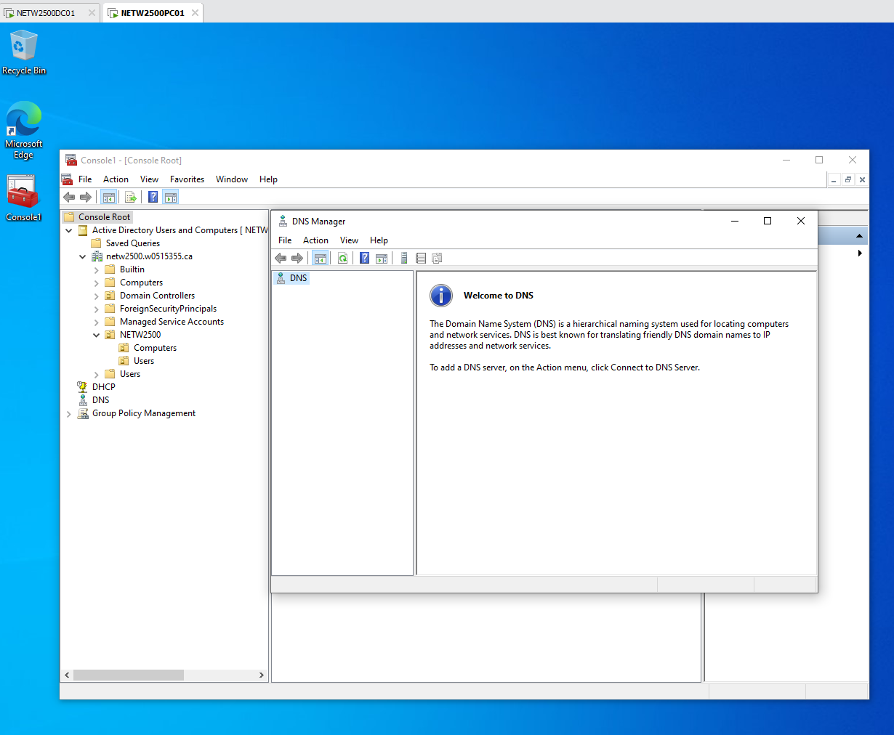
DNS

Slide 6
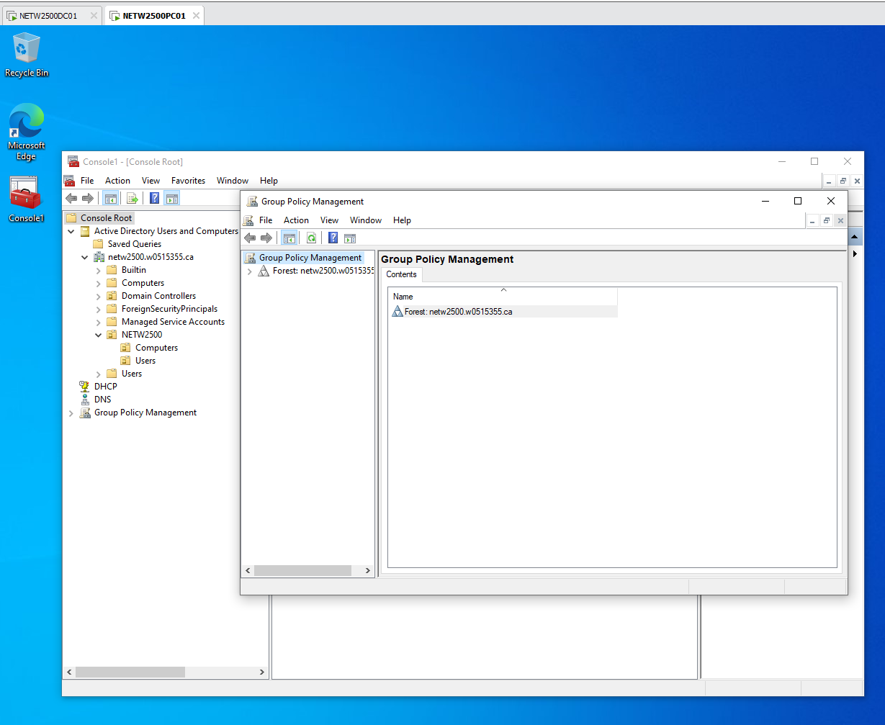
GROUP POLICY MANAGEMENT

Slide 7
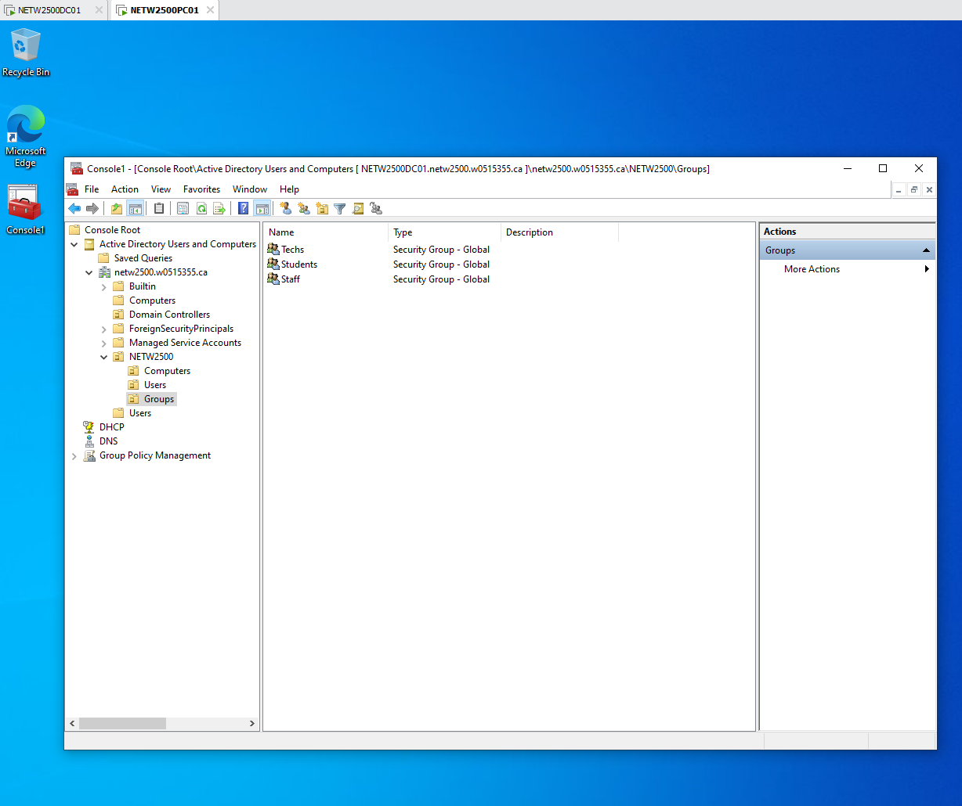
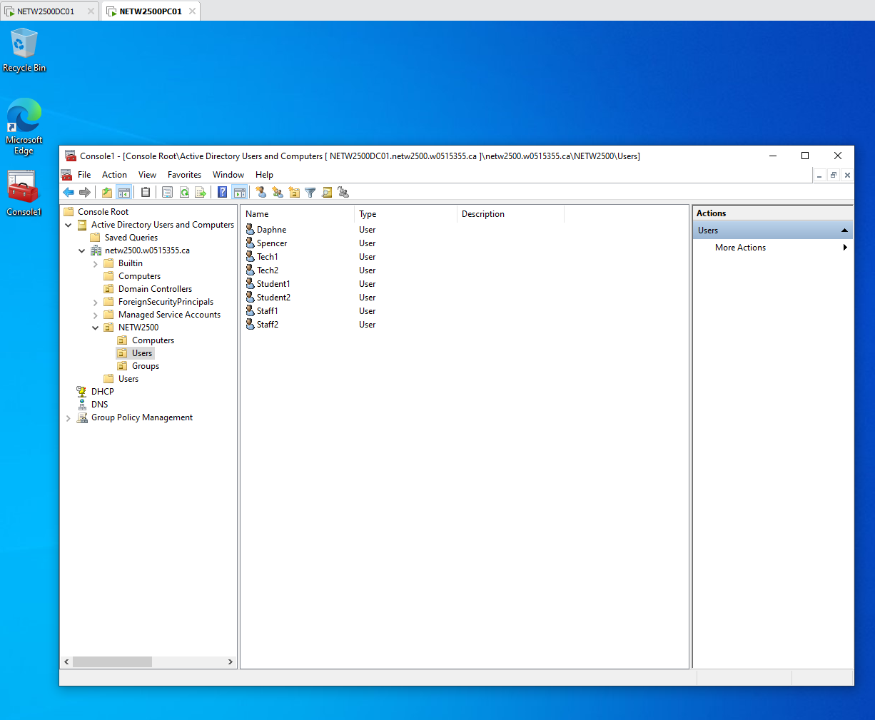
Screenshots of the requested OU structure and it's contents. 6 Users and 3 Groups

Slide 8
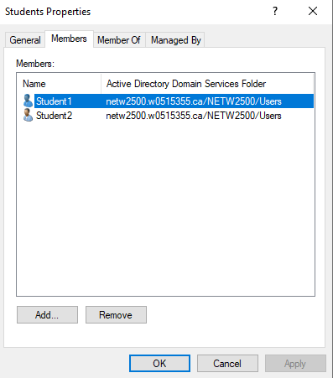
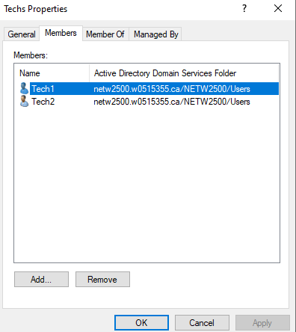
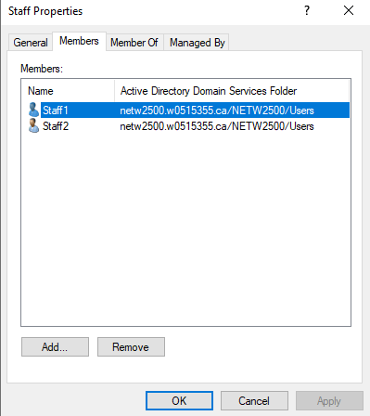

Slide 9
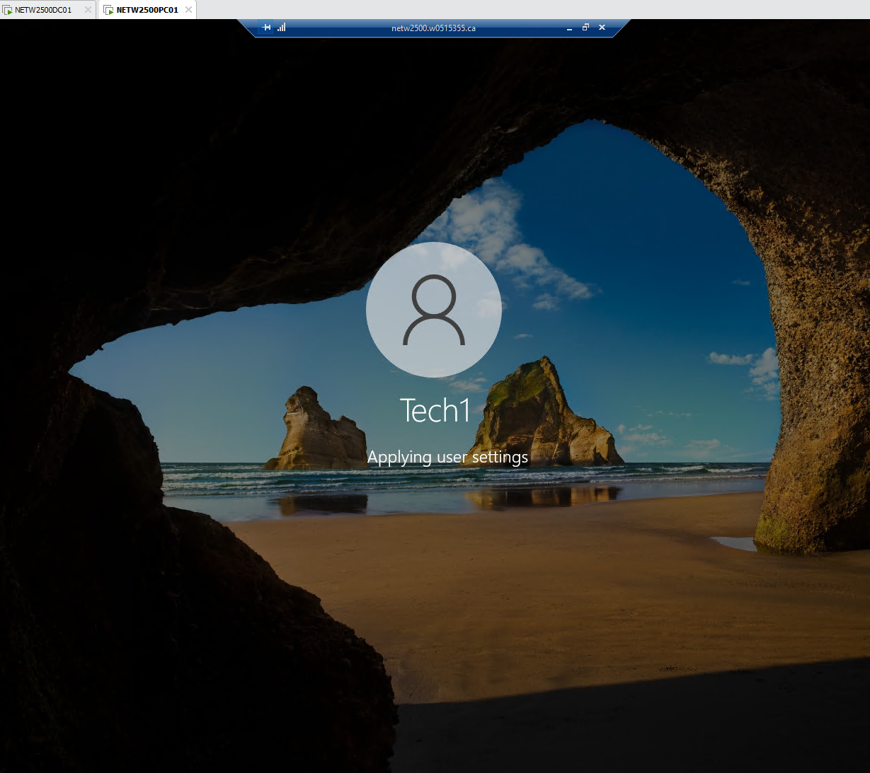
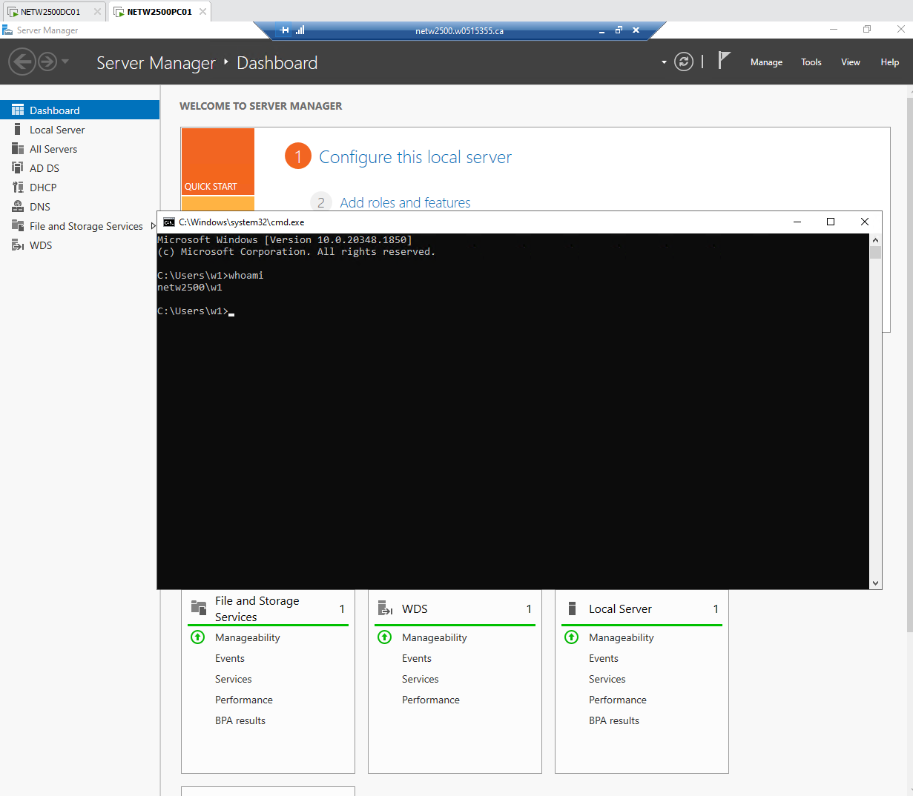
Establishing remote desktop connection, and cmd after connecting.

Slide 10
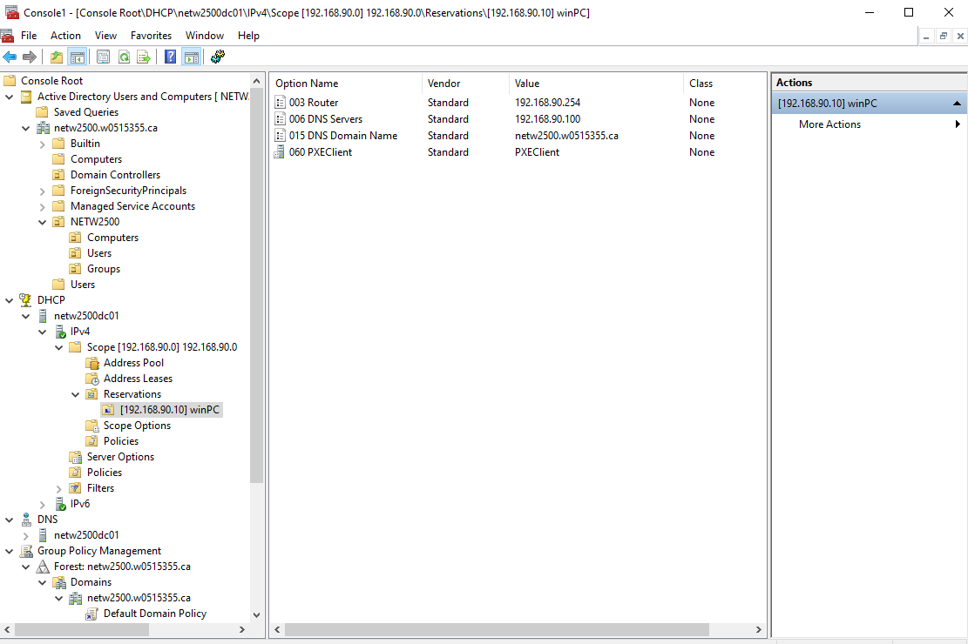
Reservation in DHCP

